Slide 1

Fuzz in a Row
Stijn Verdenius

Slide 2
Content
Introduction
Methods
Results
Discussion

Slide 3
Content
Introduction
Methods
Results
Discussion

Slide 4
Introduction
“Computational Intelligence methods have been employed to computer games since they provide dynamic and challenging elements that are similar to real world problems” (Sahin & Kumbasar, 2017)

Slide 5
Introduction
Usually applied to continuous variable kind of games
Not a lot of research done on fuzzy application on discrete decision trees (Pang, Wang, Zhou & Dong, 2004)

Slide 6
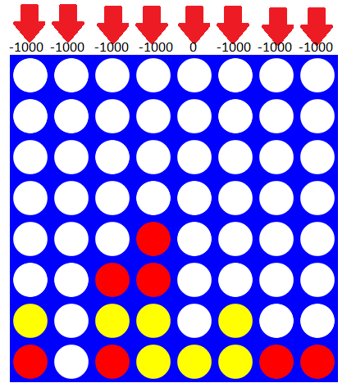
Introduction

Slide 7
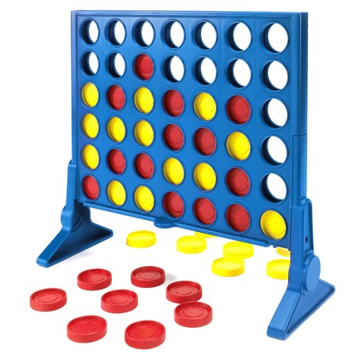
Introduction

Slide 8
Content
Introduction
Methods
Results
Discussion

Slide 9
Methods
Experiment in making an connect-4 fuzzy agent
Making it compete against
Monte Carlos search (Silver et al., 2016)
A brute force calculation (3-deep)

Slide 10
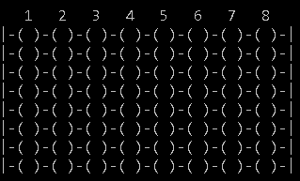
The board
Traditionally 7x6
= solved (Allis, 1988)
8
8

Slide 11
The board

Slide 12
What’s the Fuzz?
The goal is not outputting a column

Slide 13
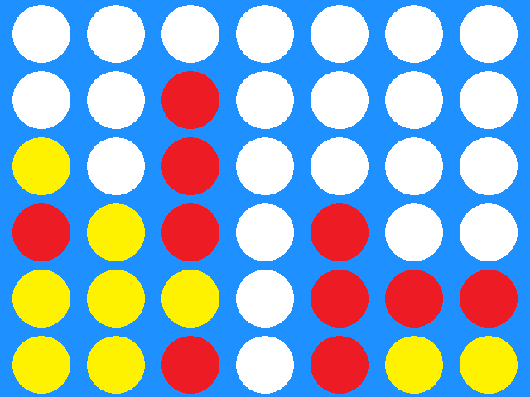
What’s the Fuzz?

Slide 14
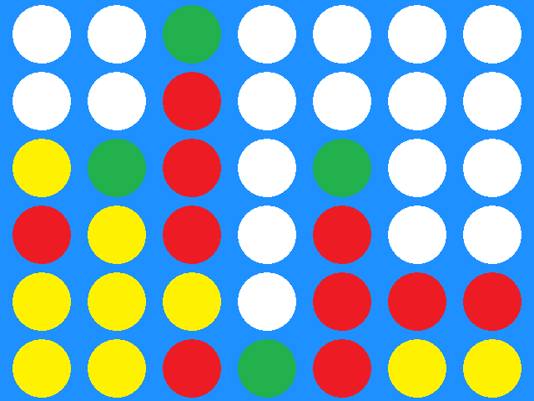
What’s the Fuzz?
2
1
4
3

Slide 15
What’s the Fuzz?
Crisp inputs
Fuzzy controller
3.6

Slide 16
What’s the Fuzz?
2
1
4
3

Slide 17
What’s the Fuzz?
2
1
4
3

Slide 18
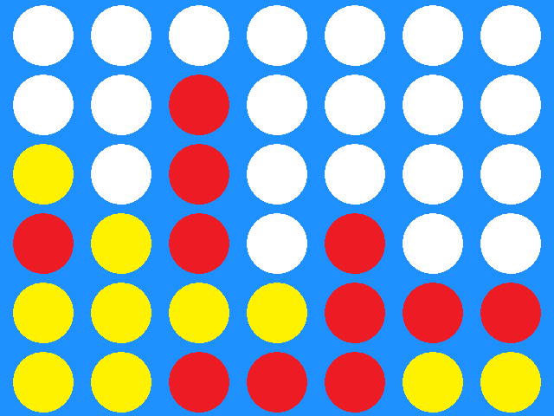
What’s the Fuzz?

Slide 19
What’s the Fuzz?
Instead:
Estimating the quality of a state
The agent can then choose the best graded move

Slide 20
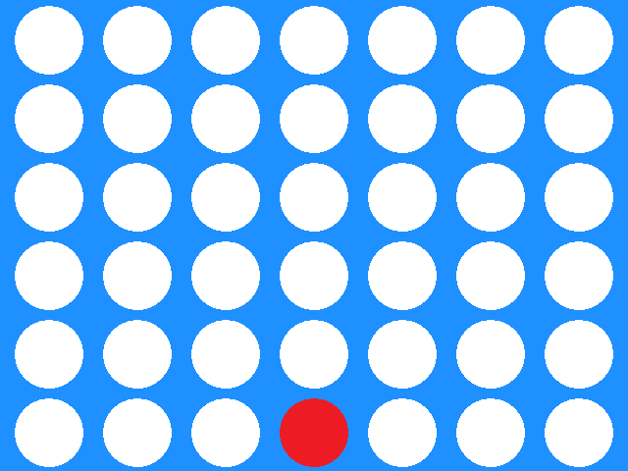
Variables
Potentials

Slide 21
Variables
Potentials
=5

Slide 22
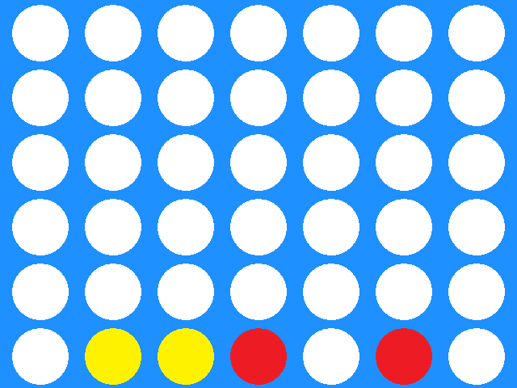
Variables
Win-In-2

Slide 23
Variables
Win-In-2
= 2

Slide 24
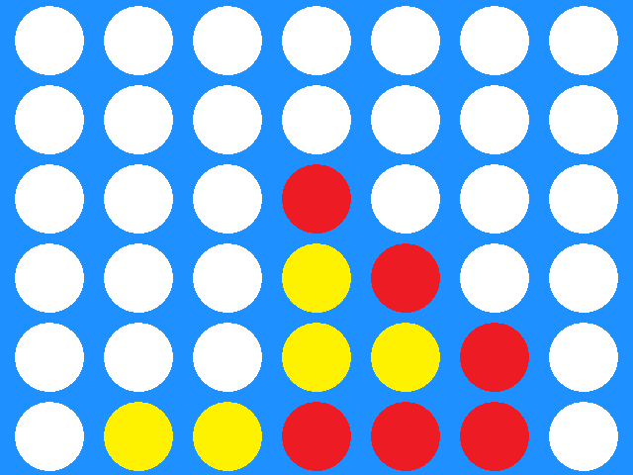
Variables
Win-In-1

Slide 25
Variables
Win-in-1
= 1

Slide 26
Variables
These same patterns can be used from previous terms
2 versions have been developed:
Uses expert knowledge and 3 variables
Uses data learning and 9 variables

Slide 27
Variables
These same patterns can be used from previous terms
2 versions have been developed:
Uses expert knowledge and 3 variables
Uses data learning and 9 variables

Slide 28
Variables
These same patterns can be used from previous terms
2 versions have been developed:
Uses expert knowledge and 3 variables
Uses data learning and 9 variables

Slide 29
Variables
Progression
= 4

Slide 30
Variables
These same patterns can be used from previous terms
2 versions have been developed:
Uses expert knowledge and 4 variables
Uses data learning and 10 variables

Slide 31

Variables
Output: a grade

Slide 32
Methods
So now we have evaluation input and output!
Still to do:
- algorithm
- fuzzy controller itself

Slide 33
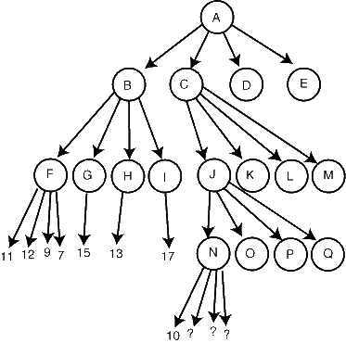
Algorithm
Decision tree
Branching factor 8
Depth 64

Slide 34
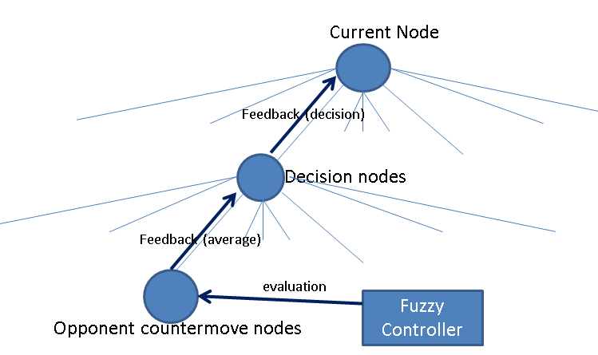
Algorithm

Slide 35
Learning
Dataset creation
Membership learning
Rule learning

Slide 36
Learning
Random walk through problem space
Evaluating each move on another AI it’s judgement
Resulting in 11.000 data points

Slide 37
Learning
Dataset creation
Membership learning
Rule learning

Slide 38
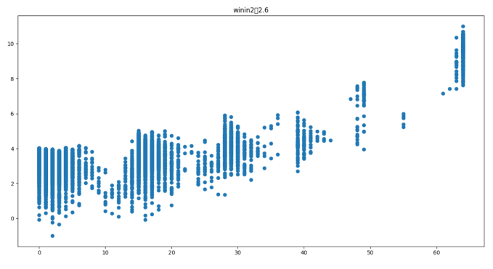
Learning
First, analyze the data on amount of clusters

Slide 39
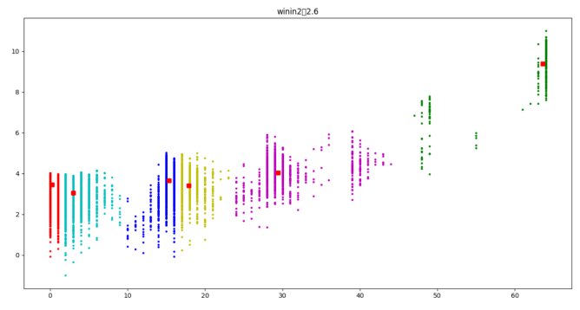
Learning
Second, do c-means

Slide 40
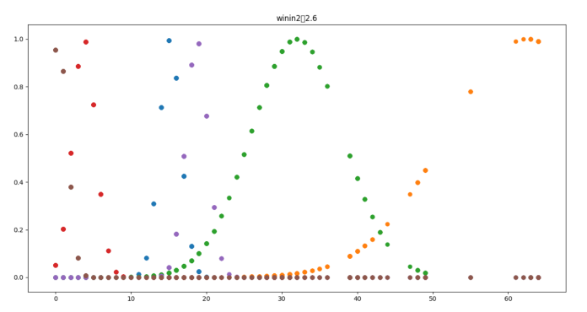
Learning
Last, project y-vector and learn memberhips

Slide 41
Learning
Dataset creation
Membership learning
Rule learning

Slide 42
Learning
Generating rules using Wang and Mendel (1992)
Resulting in 11.000 rules.
After cleanup 217 remain

Slide 43
Content
Introduction
Methods
Results
Discussion

Slide 44
Lets take it for a spin!
I am looking for a volunteer

Slide 45
Results
Fuzzy Agent starts | Monte Carlos | Brute Force
Fuzzy agent 1 | 8.75% | won
Fuzzy agent 2 | 0% | lost
Fuzzy agent 3 | 0% | lost
Opponent starts | Monte Carlos | Brute Force
Fuzzy agent 1 | 12.5% | won
Fuzzy agent 2 | 0% | lost
Fuzzy agent 3 | 3.75% | won

Slide 46
Results
Fuzzy Agent starts | Monte Carlos | Brute Force
Fuzzy agent 1 | 8.75% | won
Fuzzy agent 2 | 0% | lost
Fuzzy agent 3 | 0% | lost
Opponent starts | Monte Carlos | Brute Force
Fuzzy agent 1 | 12.5% | won
Fuzzy agent 2 | 0% | lost
Fuzzy agent 3 | 3.75% | won
Pretty fast performance
Agent based on expert knowledge works better than on data learning
Problems with firing rules in agent 2
Problems with defense mechanism agent 2

Slide 47
Content
Introduction
Methods
Results
Discussion

Slide 48
Discussion
Perhaps the dataset was not good
Could do evaluation of the moves by VICTOR (Allis, 1988)
Could be because random walk situation don’t resemble real life
Perhaps there were too many variables (Schneider & Wagemann, 2010)
Nonetheless, we should try again with an combined expert-data model (Pirovano & Lanzi, 2014)

Slide 49
Thank you ☺
Allis, L. V. (1988). A knowledge-based approach of connect-four. Vrije Universiteit, Subfaculteit Wiskunde en Informatica.
Arfi, B. (2006). Linguistic fuzzy-logic game theory. Journal of conflict resolution, 50(1), 28-57.
Dunn, J. C. (1973). A fuzzy relative of the ISODATA process and its use in detecting compact well-separated clusters.
Pang, W., Wang, K. P., Zhou, C. G., & Dong, L. J. (2004, September). Fuzzy discrete particle swarm optimization for solving traveling salesman problem. In Computer and Information Technology, 2004. CIT'04. The Fourth International Conference on (pp. 796-800). IEEE.
Pirovano, M., & Lanzi, P. L. (2014). Fuzzy Tactics: A scripting game that leverages fuzzy logic as an engaging game mechanic. Expert Systems with Applications, 41(13), 6029-6038.
Sahin, A., & Kumbasar, T. (2017, July). Landing on the moon with type-2 fuzzy logic. In Fuzzy Systems (FUZZ-IEEE), 2017 IEEE International Conference on (pp. 1-6). IEEE.
Silver, D., Huang, A., Maddison, C. J., Guez, A., Sifre, L., Van Den Driessche, G., ... & Dieleman, S. (2016). Mastering the game of Go with deep neural networks and tree search. Nature, 529(7587), 484-489.
Schneider, C. Q., & Wagemann, C. (2010). Standards of good practice in qualitative comparative analysis (QCA) and fuzzy-sets. Comparative Sociology, 9(3), 397-418.
Wang, L. X., & Mendel, J. M. (1992). Generating fuzzy rules by learning from examples. IEEE Transactions on systems, man, and cybernetics, 22(6), 1414-1427.

